Slide 1
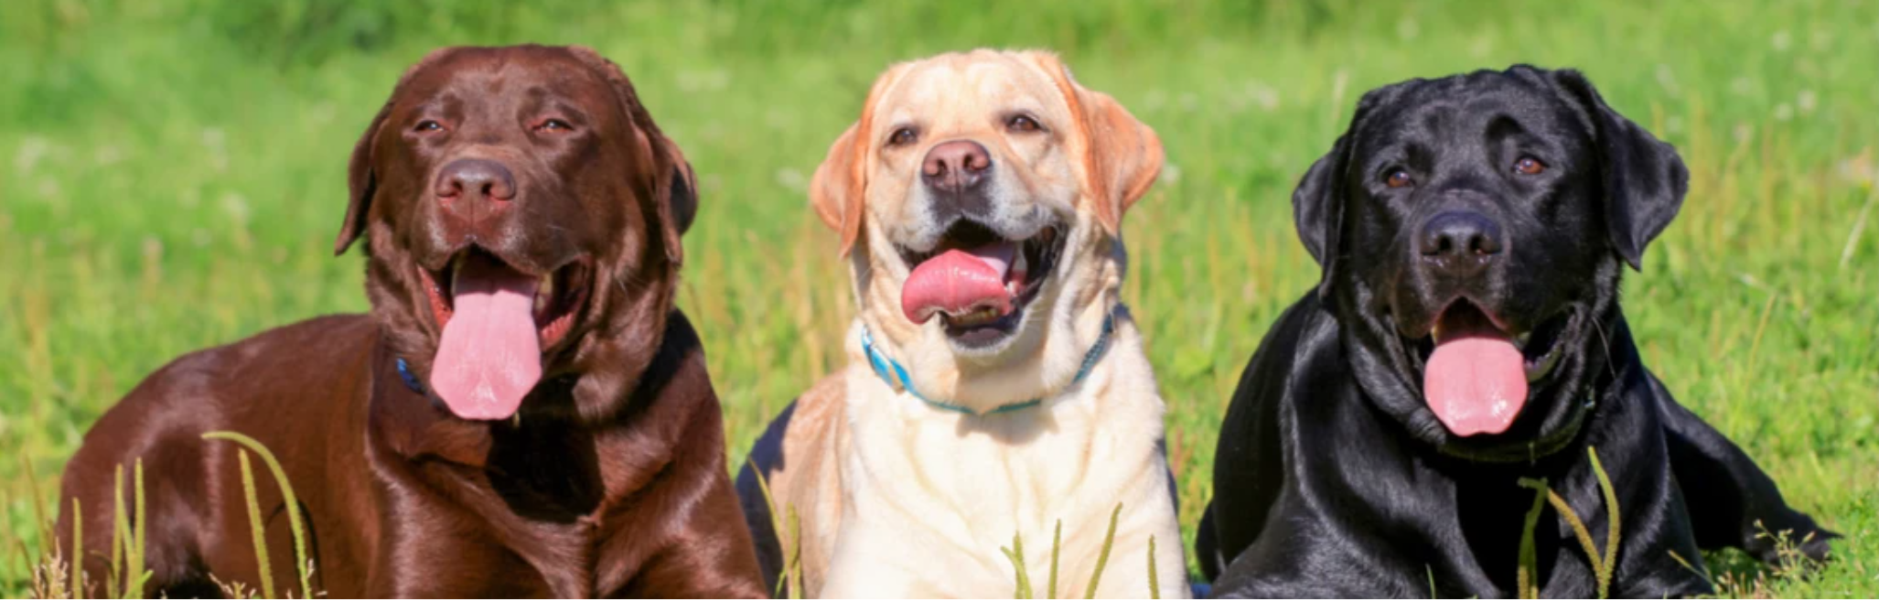
Canine Heart Health: Classification of Cardiomegaly (enlarged heart) in Veterinary X-ray Images
Presenter:
Jeremy Ramirez, DrPH, MPH
GitHub link

Slide 2

Motivation
Study Question: How do different hyperparameters affect the accuracy and loss in classifying cardiomegaly in canine x-ray images?
What is Vertebral Heart Size (VHS): VHS is a radiographic measurement of heart size in dogs, using the length of the heart's long and short axes compared to the thoracic vertebrae. It is used to detect cardiomegaly (enlarged heart).
Why is it important to classify VHS conditions in dogs:
To detect heart disease early.
Track disease progression and treatment efficacy.
Predicts outcomes and life expectancy.
What has been done before in this space:
Several studies have examined VHS from radiographs to develop ML algorithms to predict heart disease ^{1, 3, 5-6}.
Notes:
Jeremy

Slide 3
Motivation (Cont’d)
Overall plan (to approach research question):
Data collection
Data preprocessing
Baseline model
Improved model
Experimental analysis
Notes:
Jeremy

Slide 4
Motivation (Cont’d)
Summary of Results:
High-level overview of what was achieved:
Developed multiple Convolutional Neural Network (CNN) architectures (Model1, Model2, Model3).
Improved model stability and and slightly reduced loss by refining the architecture and hyperparameters.
Notes:
Jeremy

Slide 5
Data
Dataset Description:
Name: Radiographic Dataset for VHS Determination Learning Process
Source: Small Animal Veterinary Teaching Hospital, Veterinary Sciences Research Institute, Autonomous University of Baja California (2019-2020)⁴
Image Acquisition System: Universal AV Choice X-Ray System and Rayence XMARU 1417PGA-PCA 14x17” cassette digital detector (DR system)
Conversion: Images converted from DICOM to PNG format
Cropping: Cropped to remove unnecessary boundaries
Anonymization: All fields that could enable patient identification were removed.
Notes:
Jeremy

Slide 6
Data (Cont’d)
Details and Statistics:
Number of Images: 153
Types of Images: Lateral thoracic radiographic images
Coding VHS Values ²:
”0” = Normal (<10.5)
“1” = Mild (10.6 – 11.0)
“2” = Moderate (11.1 – 12.0)
“3” = Severe (>12.0)
Notes:
Jeremy

Slide 7

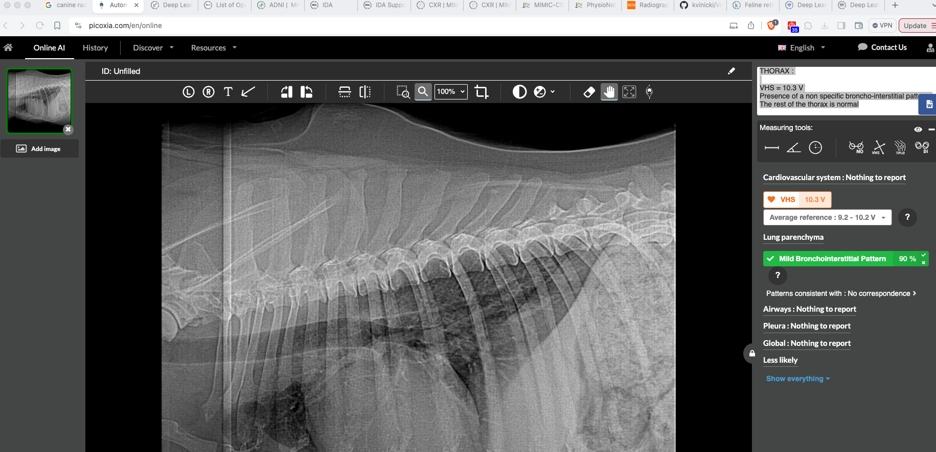

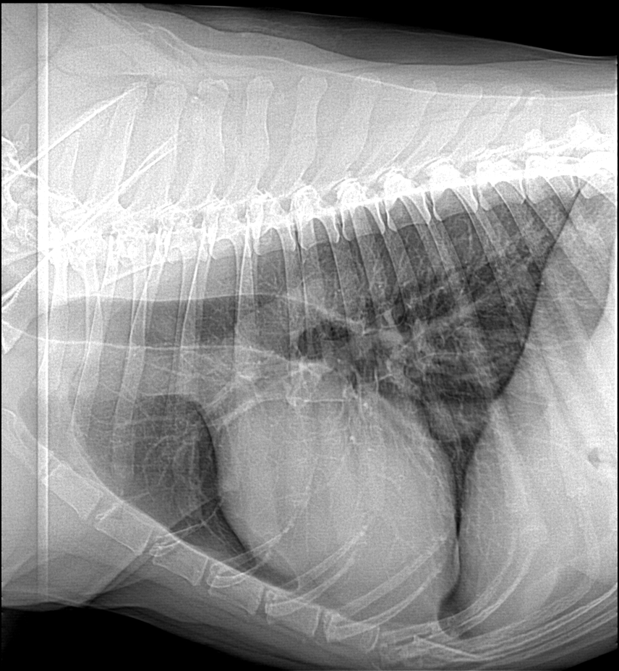
Radiograph
Vertebrae
Heart

Slide 8
Data (Cont’d)
Data Preprocessing:
Missing Values: Labels were not originally included in dataset. Manual assignment of labels based on VHS values.
Datasets: Split the dataset into training, validation, and test sets.
Data Augmentation: Transformations applied (rotation, zoom, horizontal flip, etc.)
Normalization: Normalize pixel values to the range [0, 1]
Resizing and Cropping:
Standard image size (224x224 pixels)
Removing unwanted boundaries

Slide 9
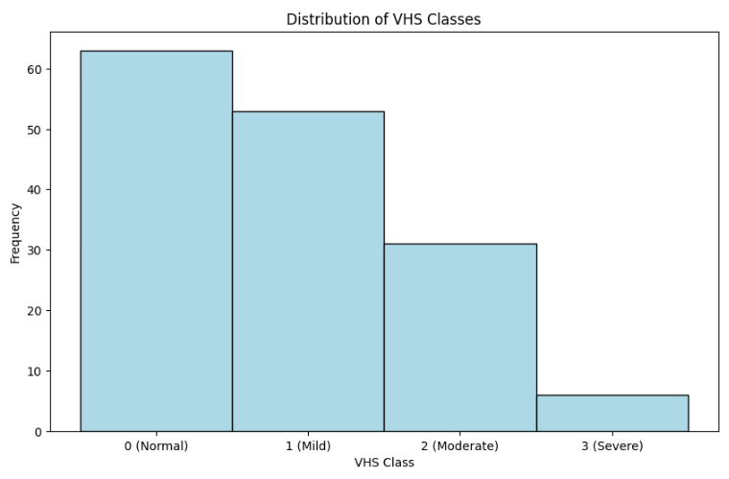
Data (Cont’d)

Slide 10
Modeling
Models
Input Layer: 224x224x3
Convolution Layers:
32 filters, 3x3 kernel, ReLU activation
64 filters, 3x3 kernel, ReLU activation
128 filters, 3x3 kernel, ReLU activation
Pooling Layers: MaxPooling2D, 2x2 pool size (after each Conv layer)
Dropout Layers: 0.3 rate (after each Pooling layer), 0.5 rate (before final Dense layer)
Flatten Layer: Converts 3D feature maps to 1D
Dense Layers:
512 units, ReLU activation
1 unit, Sigmoid activation
Notes:
Jeremy

Slide 11
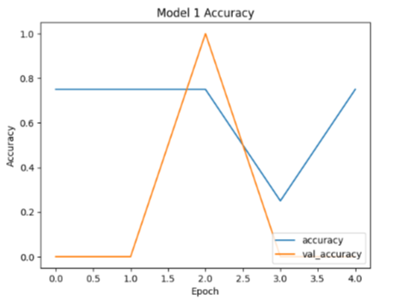
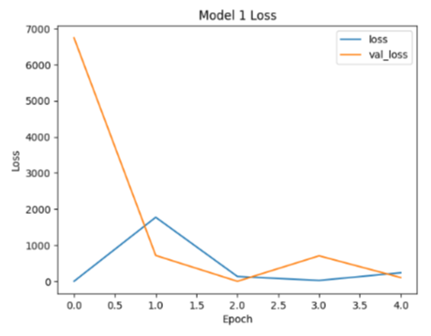
Modeling (Cont’d)
Baseline Model: Model 1
Notes:
Jeremy

Slide 12
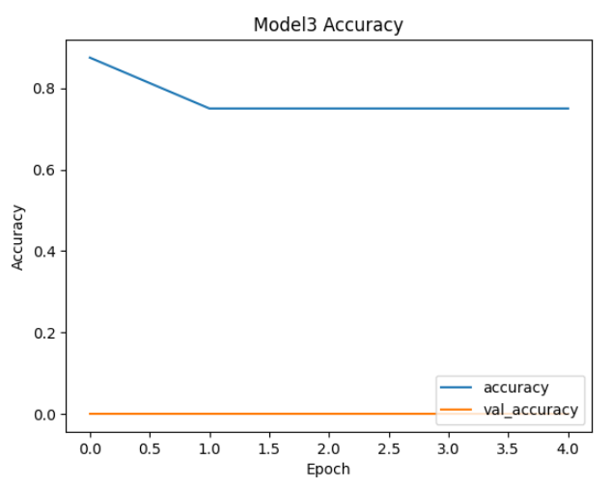
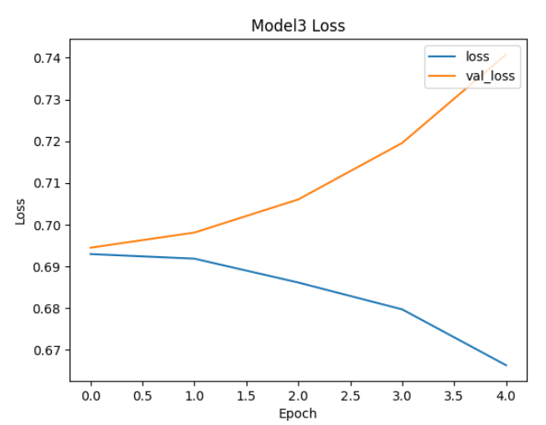
Modeling (Cont’d)
Improved Model: Model 3
Notes:
Jeremy

Slide 13
Experiments
Hyperparameter Choices: Insights into different choices and their effects
Learning Rate (0.001, 0.0001): Lower learning rates resulted in more stable training and lower loss values.
Batch Size (16, 32, 64): Larger batch sizes led to faster training times, but sometimes resulted in higher validation loss.
Dropout Rate (0.3, 0.5): Higher dropout rates improved generalization and reduced overfitting.
Number of Filters in Conv Layers (32, 64, 128): Increasing the number of filters improved the model's ability to capture features.
Optimizer (Adam, SGD): Adam provided faster convergence and better performance compared to SGD.
Notes:
Jeremy

Slide 14
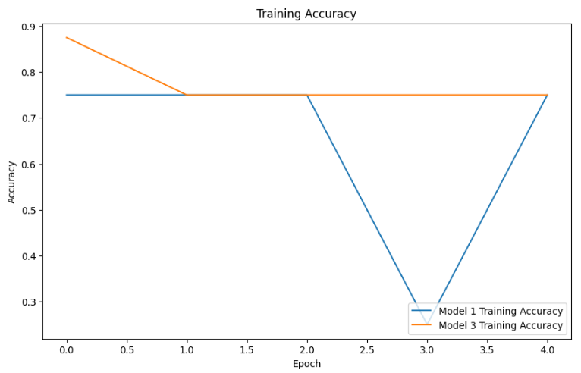
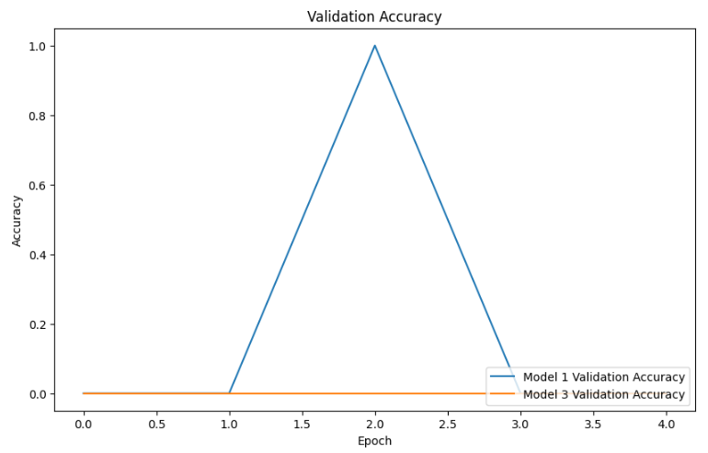
Experiments (Cont’d)
Visualization graphs of experimental results between models
Notes:
Jeremy

Slide 15
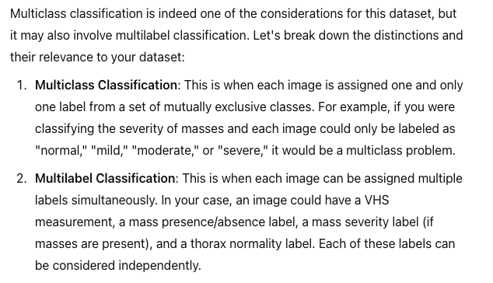
Conclusions
Key Results:
Model 3 achieved the highest training accuracy (0.87 compared to Model 1 at 0.75).
Validation accuracy remained at 0.00 across all models.
Training losses for Models 2 and 3 were comparable and lower than Model 1.
Lessons Learned:
Importance of Hyperparameters
Validation Set
Future Work:
Improving validation accuracy and larger dataset
Notes:
Jeremy

Slide 16
References
Boissady, E., De La Comble, A., Zhu, X., Abbott, J., & Adrien-Maxence, H. (2021). Comparison of a deep learning algorithm vs. humans for vertebral heart scale measurements in cats and dogs shows a high degree of agreement among readers. Frontiers in Veterinary Science, 8, 764570.
Buchanan, J. W., & Bücheler, J. (1995). Vertebral scale system to measure canine heart size in radiographs. Journal of the American Veterinary Medical Association, 206(2), 194-199.
Burti, S., Osti, V. L., Zotti, A., & Banzato, T. (2020). Use of deep learning to detect cardiomegaly on thoracic radiographs in dogs. The Veterinary Journal, 262, 105505.
Flores Duenas, C. A., Gaxiola Camacho, S. M., & Montaño Gómez, M. F. (2020). Radiographic dataset for VHS determination learning process (Version 1) [Dataset]. Mendeley Data. Retrieved from: https://data.mendeley.com/datasets/ktx4cj55pn/1
Solomon, J., Bender, S., Durgempudi, P., Robar, C., Cocchiaro, M., Turner, S., ... & Szlosek, D. (2023). Diagnostic validation of vertebral heart score machine learning algorithm for canine lateral chest radiographs. Journal of Small Animal Practice, 64(12), 769-775.
Zhang, M., Zhang, K., Yu, D., Xie, Q., Liu, B., Chen, D., ... & Liu, C. (2021). Computerized assisted evaluation system for canine cardiomegaly via key points detection with deep learning. Preventive Veterinary Medicine, 193, 105399.
Notes:
Jeremy

Slide 17

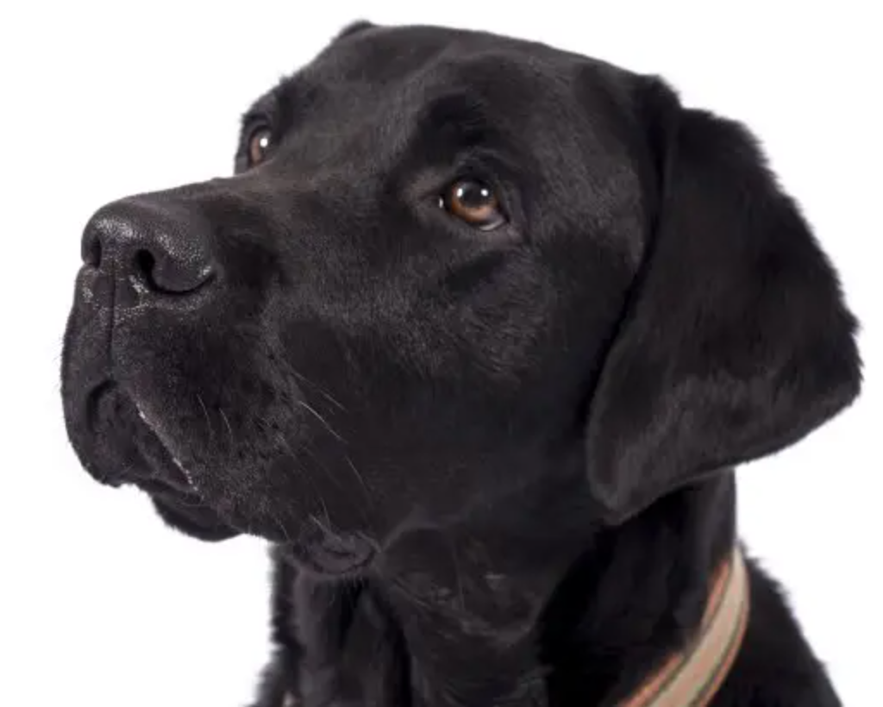
?

Slide 18
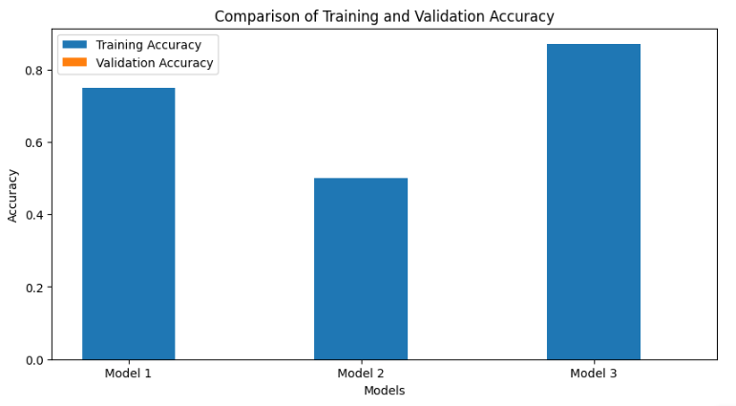
Experiments (Cont’d)
Tables, Figures, and Graphs: Comparison between baseline and improved model performance
Notes:
Jeremy

Slide 19
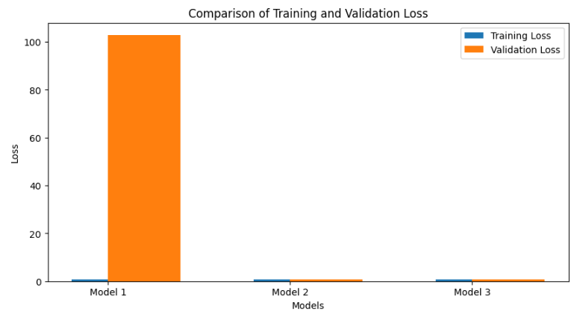
Experiments (Cont’d)
Tables, Figures, and Graphs: Comparison between baseline and improved model performance
Notes:
Jeremy

Slide 20
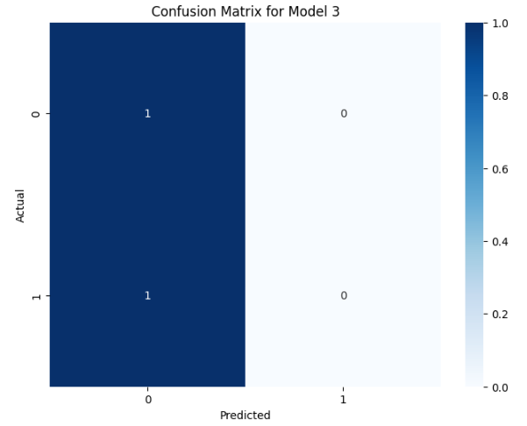
Experiments (Cont’d)
Tables, Figures, and Graphs: Comparison between baseline and improved model performance
Notes:
Jeremy

